Slide 1
Python (day 1)
Nick Anderson

Slide 2
Intro to Python
Welcome to Python!!!
Python is actually used in production in APIs, web apps, data analysis, and dev-ops (development operations).
Python is very similar to VBA scripting with programming concepts (iteration, conditionals, etc.), just slightly easier syntax.

Slide 3
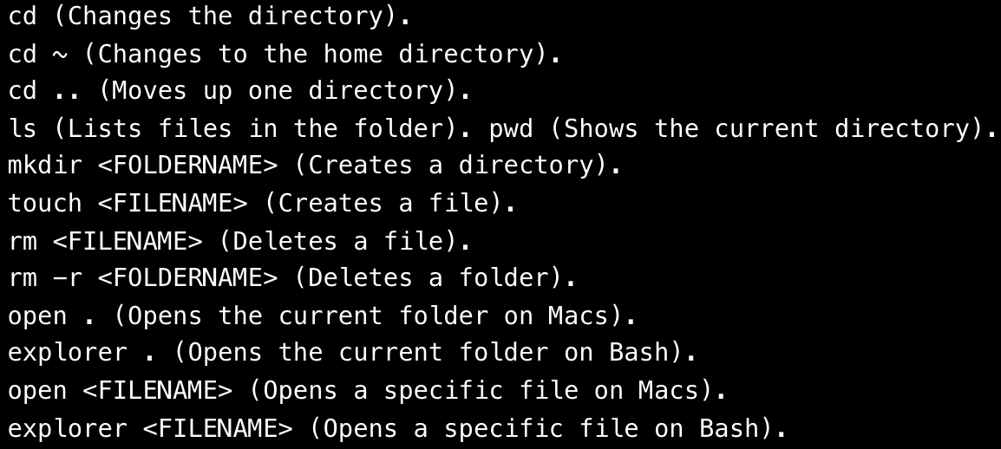
Terminal

Slide 4
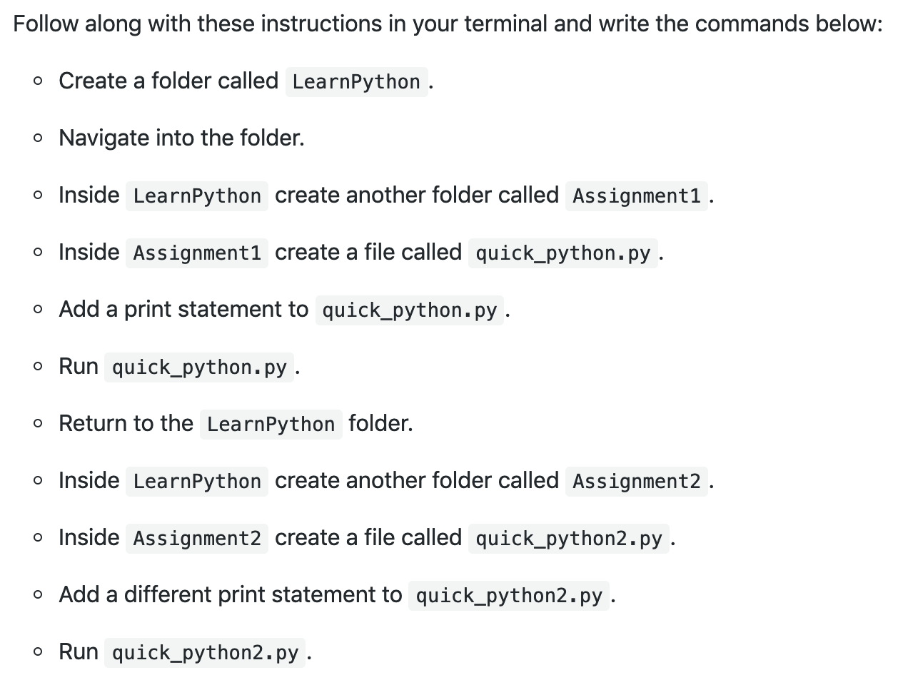
(your turn,
10 min.)

Slide 5
Check Anaconda (everyone, 5 min.)
The most common problem will be with Windows not having the Anaconda PATH variable set. This can be fixed by manually adding the PATH to Windows' environment variables, but can be more easily solved by uninstalling/reinstalling Anaconda and making sure to check the "Install to Path" box that comes up in a menu.

Slide 6
Create Virtual Env. (everyone, 10 min.)
Run ‘conda create -n PythonData python=3.6 anaconda’ in the terminal. This may take a few minutes to install.
Now enter 'source activate PythonData' to activate the environment. When (PythonData)$ appears, this means you are in the environment.
Verify correct version of Python by entering 'python --version'. Exit by entering 'source deactivate'.
Click HERE to review environment commands.

Slide 7
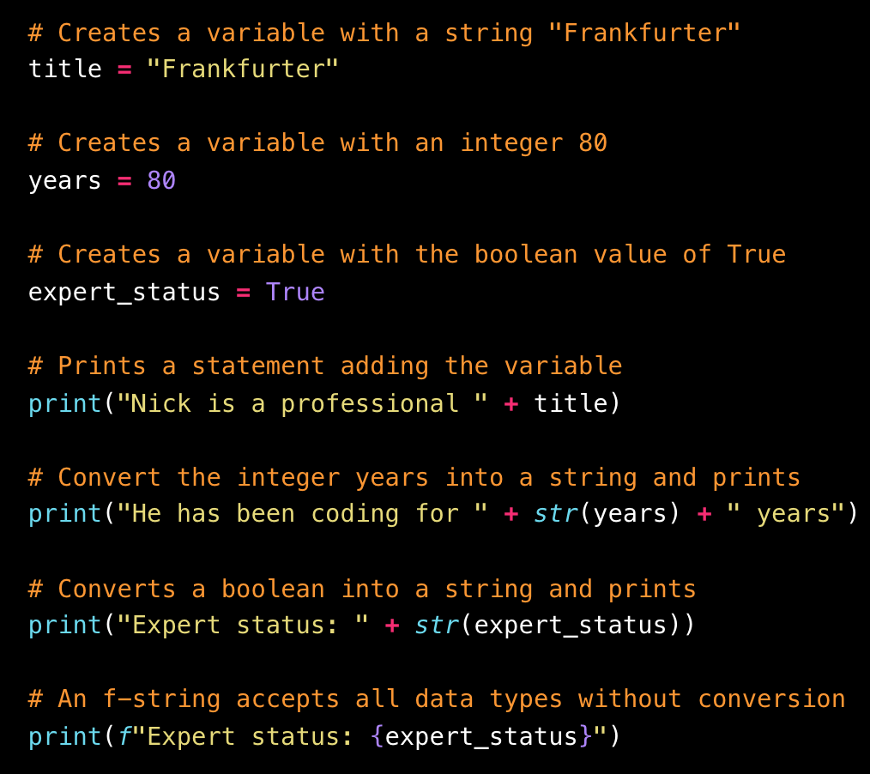
Variables
Read more about strings at the URL below.
https://realpython.com/python-f-strings/

Slide 8
Hello Variables World! (your turn, 10 min.)
Create two string variables called "name" and "country"
Create two integer variables called "age" and "hourly_wage"
Create a boolean variable called "satisfied"
Create an integer variable called "daily_wage" that will hold the value of "hourly_wage" multiplied by 8
Provide print statements for all of the above variables

Slide 9
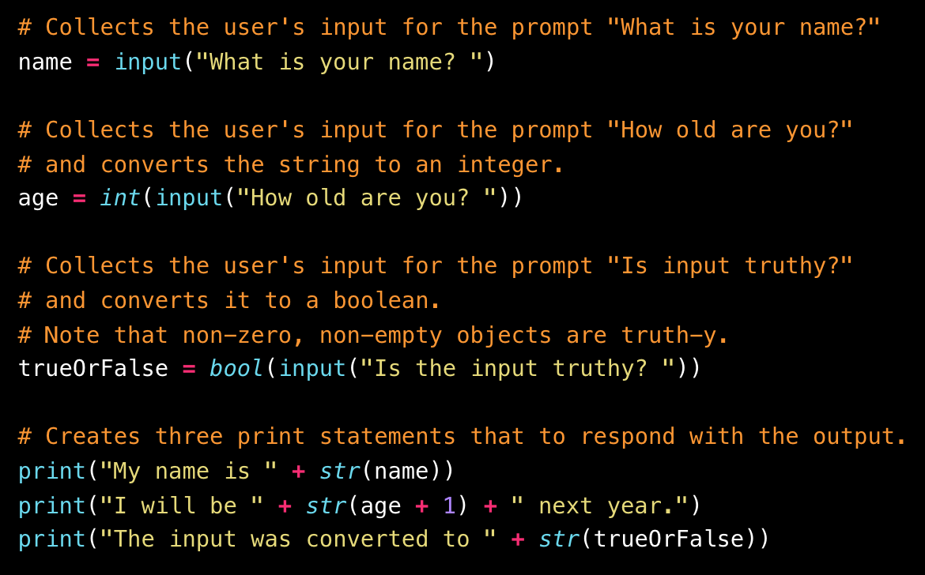
Inputs & Prompts

Slide 10
Down To Input (your turn, 7 min.)
Create two different variables that will take the input of your first name and your neighbor's first name.
Create two more inputs that will ask how many months each of you has been coding.
Finally, display a result with both your names and the total amount of months coding.

Slide 11
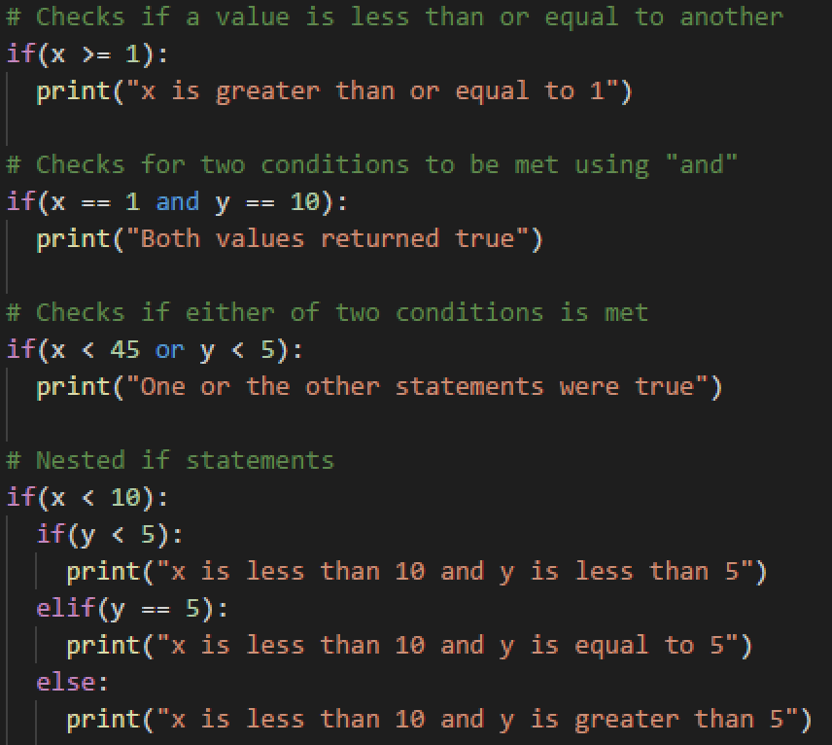
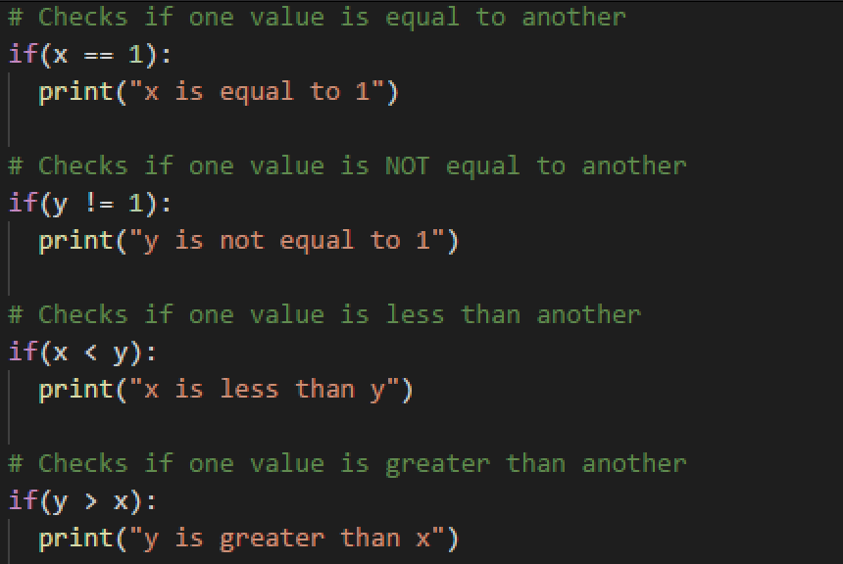
Conditionals

Slide 12
Conditional Conundrum (your turn, 10 min.)
Figure out which lines will be printed to the console.
Do not run the application, see if you can follow the thought process for each chunk of code and then place a guess. Run the application after you place a guess.
Bonus: create your own series of conditionals to test your fellow students. Once you have completed your puzzle, slack it out to everyone so they can test it.

Slide 13
Break (40 minutes)

Slide 14
Lists/Tuples
'append' adds elements to the end of the list.
'index' returns the numeric location of a given value within a list.
The 'len' function returns the length of a list.
The 'remove' method deletes a given value from a list.
The 'pop' method removes a value by index.
Note: indexing in lists starts at 0.

Slide 15
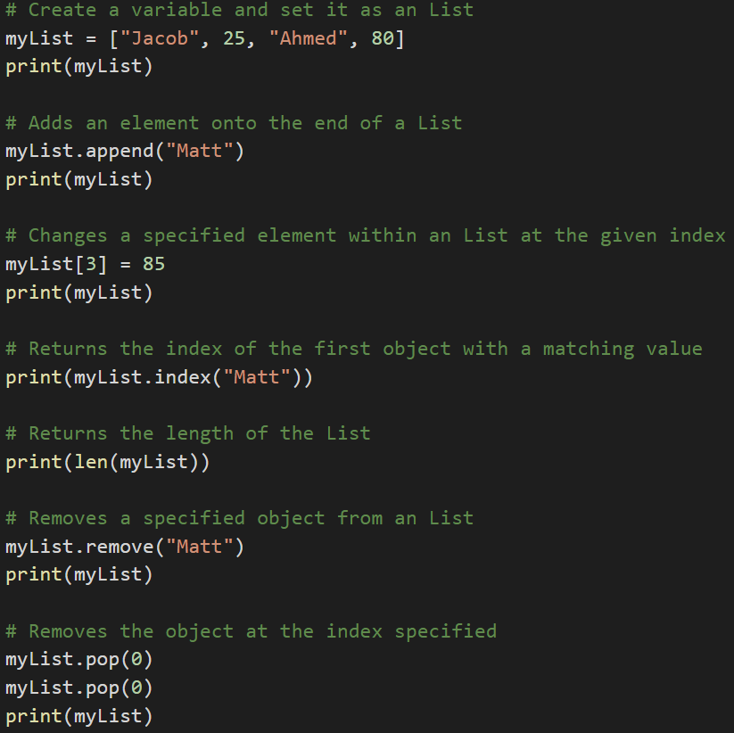
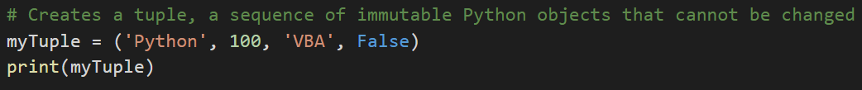
Lists/Tuples

Slide 16
Rock, Paper, Scissors (your turn, 15 min.)
Take terminal inputs r, p or s (rock, paper, and scissors).
Use ‘random’ to pick one of these three choices.
Compare the user's input to the computer's choice to determine if the user won, lost, or tied. Hint: look into this stackoverflow question for help on using the ‘random’ module to select a value from a list. https://stackoverflow.com/questions/306400/how-to-randomly-select-an-item-from-a-list

Slide 17
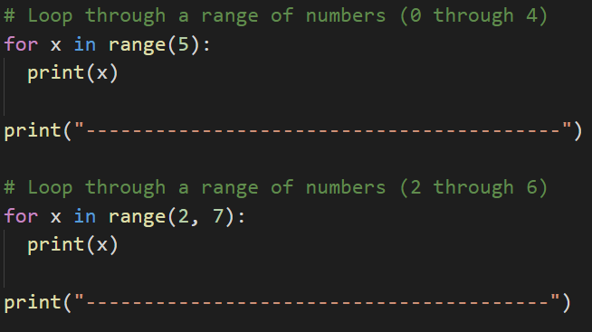
Iteration

Slide 18
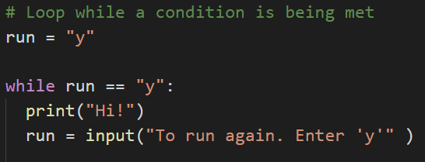
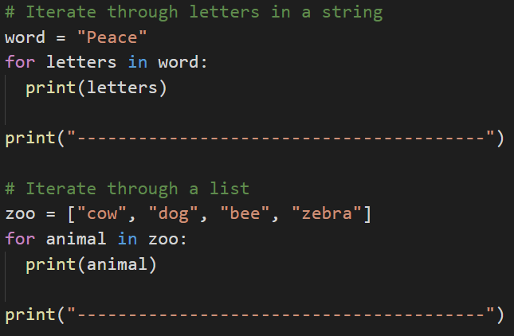
Iteration
(continued)

Slide 19
Number Chain (your turn, 14 min.)

Slide 20
Number Chain (your turn, 14 min.)
With a while loop, ask the input "How many numbers?", then print out a chain of numbers from 0 to the number.
Ask the user if they would like to continue "y/n". If "y", repeat step 1. If "n" is entered, exit the application. Bonus: rather than just displaying numbers starting at 0, have the numbers begin at the end of the previous chain.

Slide 21
Python Check-Up (your turn, 10 min.)

Slide 22
Python Check-Up (your turn, 10 min.)
Print "Hello User!"
Then ask: "What is your name? "
Then respond: "Hello <user's name>"
Then ask: "What is your age? "
Then respond: "Awww... you're just a baby!" or "Ah... A well traveled soul are ye." depending on the user's age.
Hints: remember to cast your variables!

Slide 23
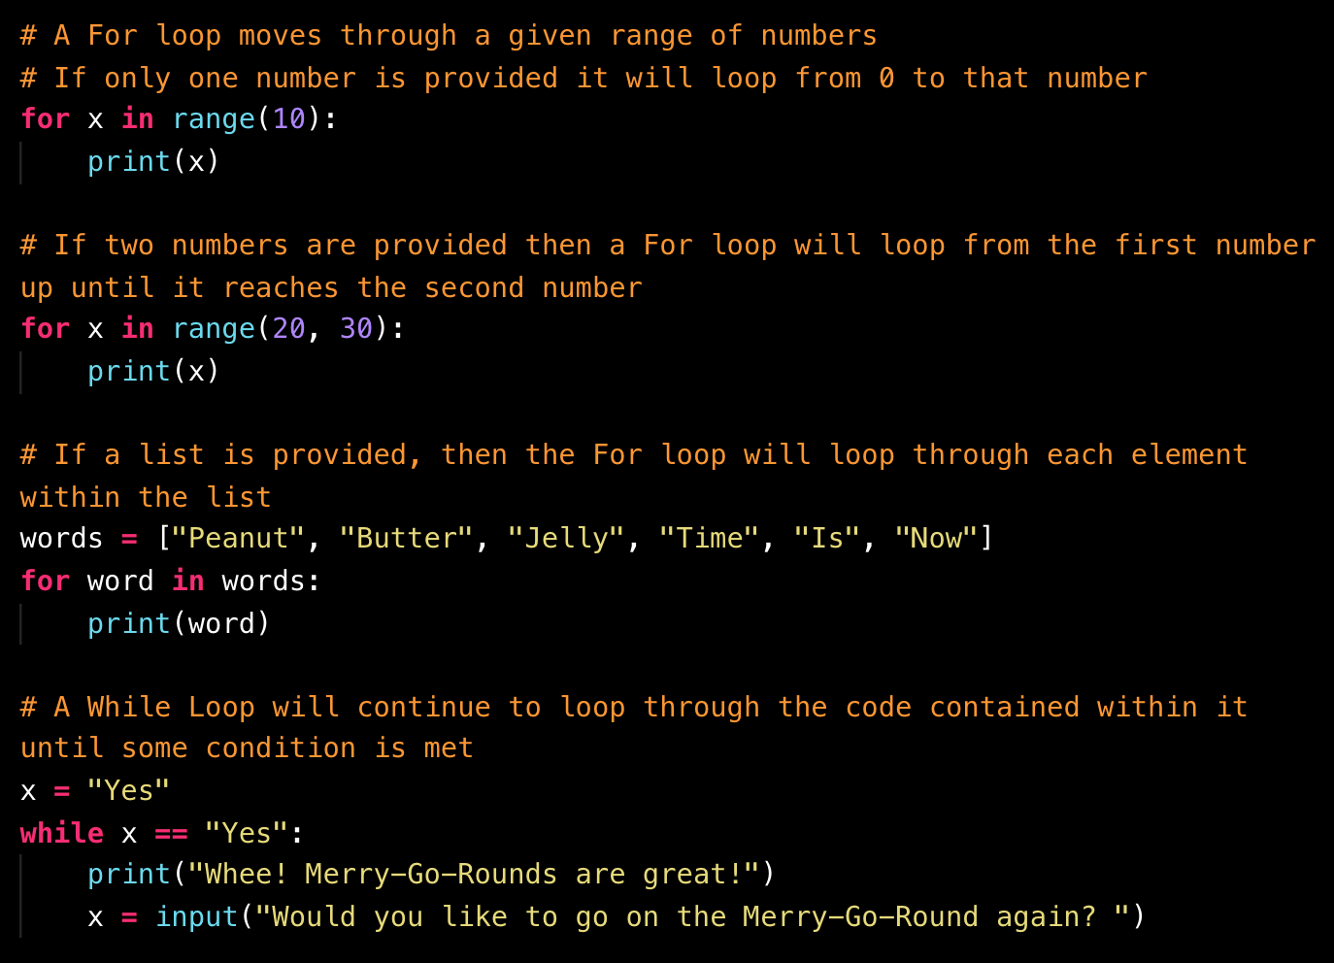
Loop Recap

Slide 24
Kid in a Candy Store

Slide 25
Kid in a Candy Store (your turn, 15 min.)
Print all of the candies with their index.
Run the loop for the number of times as determined by the variable allowance.
Each time the second loop runs, take in a user's input (as an integer), then add the candy with a matching index to the variable "candyCart".
Use another loop to print all of the candies selected to the terminal.

Slide 26
House of Pies

Slide 27
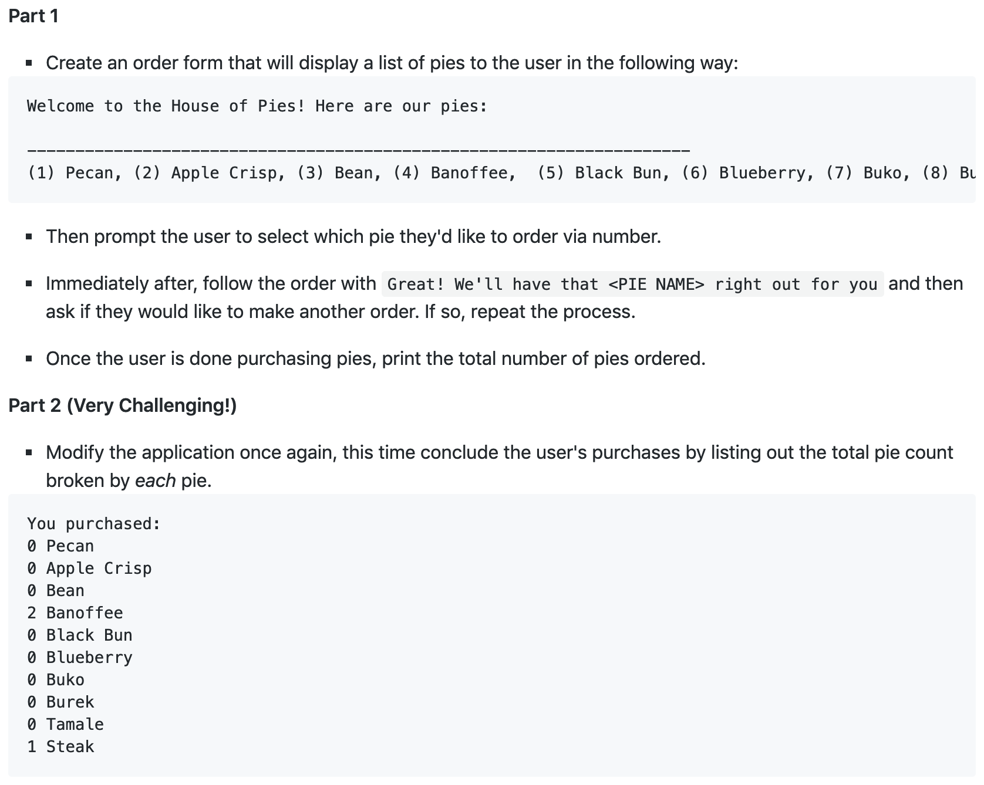
(your turn, 20 min.)

Slide 28
Homework: PyBank and PyPoll
Read in CSV file(s)
Formulate with Python
Output the results to the terminal
Export results to a text file
Note: Please review & code the concepts today. Review the homework to prepare for next class. Next class will cover importing modules for reading and writing files.

